Slide 1
CS 513 Final Project Presentation
Group 9: Benjamin Singleton, Guizhi Xu, Janmejay Mohanty, Yipeng Yang

Slide 2




Team
Benjamin Singleton
Section B
10448204
Guizhi Xu
Section B
20008770
Janmejay Mohanty
Section B
20009315
Yipeng Yang

Slide 3
Problem Statement
HR departments put significant time and effort into hiring the right people; however, in our modern culture there is little employee loyalty. Employees often leave companies after short periods of time to pursue roles that they perceive as better.
If companies could predict what employees are likely to remain employed and likely to leave it would allow them to react and ensure a desirable outcome.
By using various classification algorithms, we can attempt to predict if a whether or not a given employee will stay with the company or not.

Slide 4
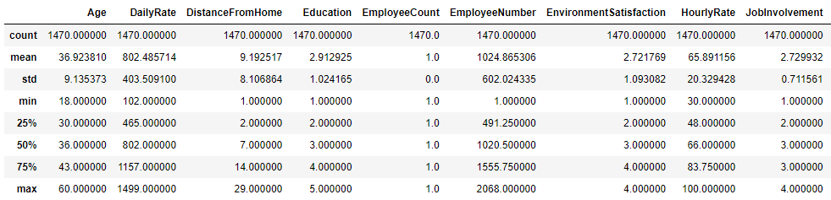
Data
Our dataset was found on Kaggle:
https://www.kaggle.com/datasets/whenamancodes/hr-employee-attrition
It contains 35 columns and 1470 rows. 8 of the columns are categorical while the rest are numerical. We are concerned with the Attrition column which indicates whether or not a given employee stayed with the company.

Slide 5
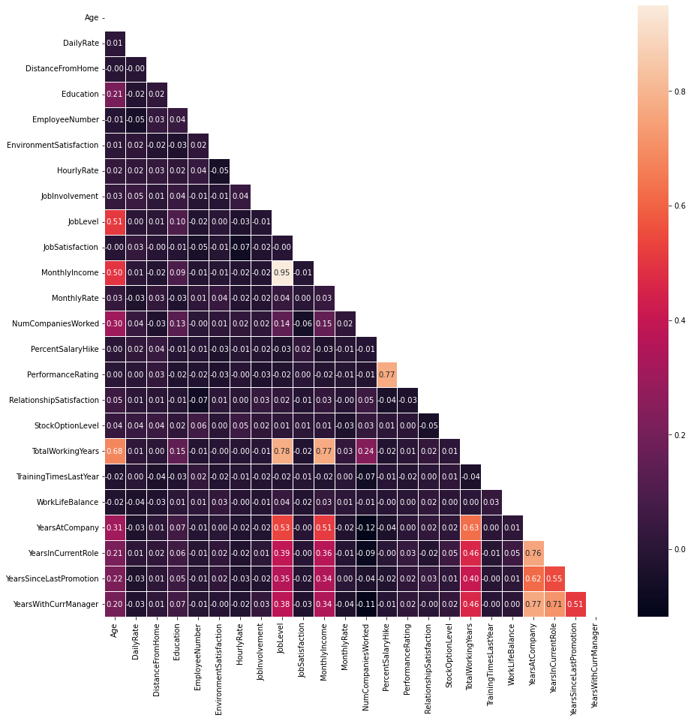
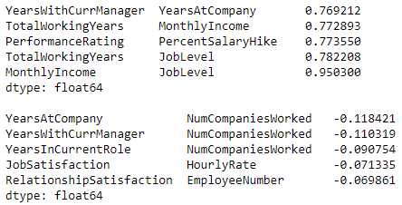
EDA - Correlation

Slide 6
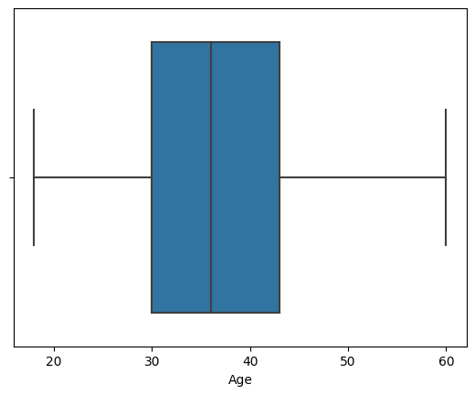
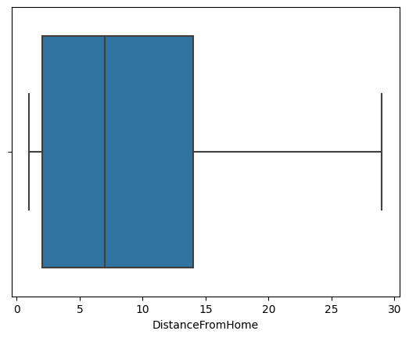
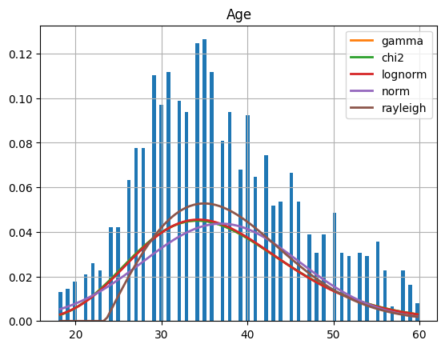
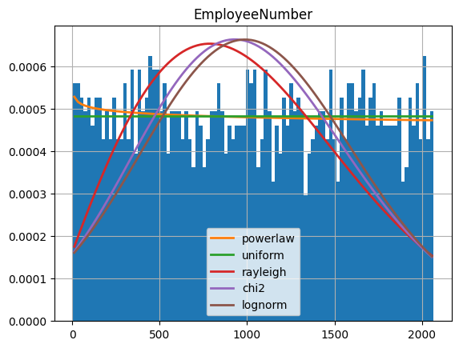
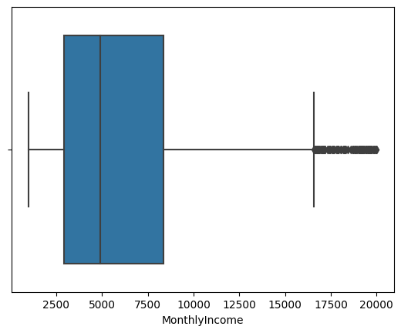
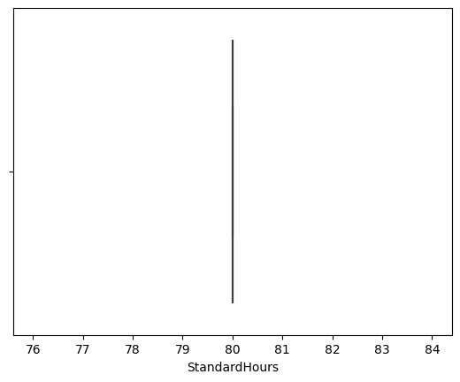
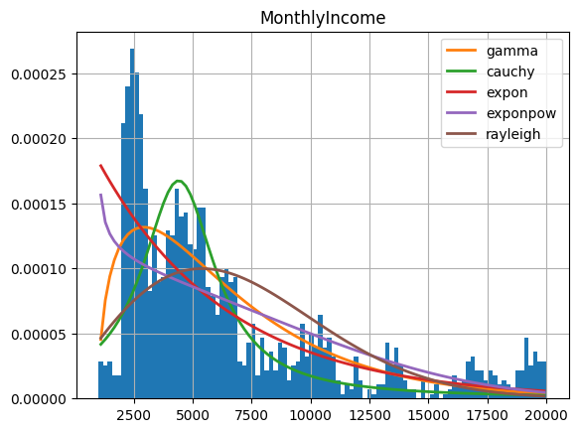
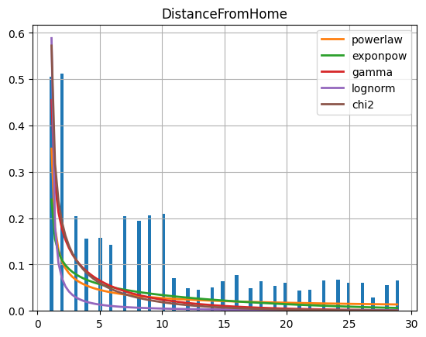
EDA - Distributions
Boxplots were useful for getting an initial feel for the data.
Utilized a library known as “fitter” to find the closest distribution for each columns, revealing more insights.

Slide 7
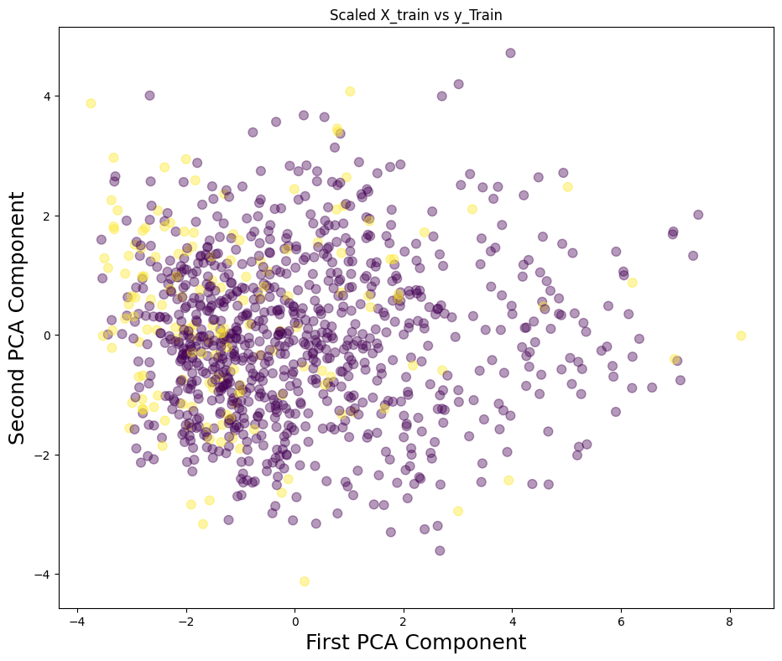
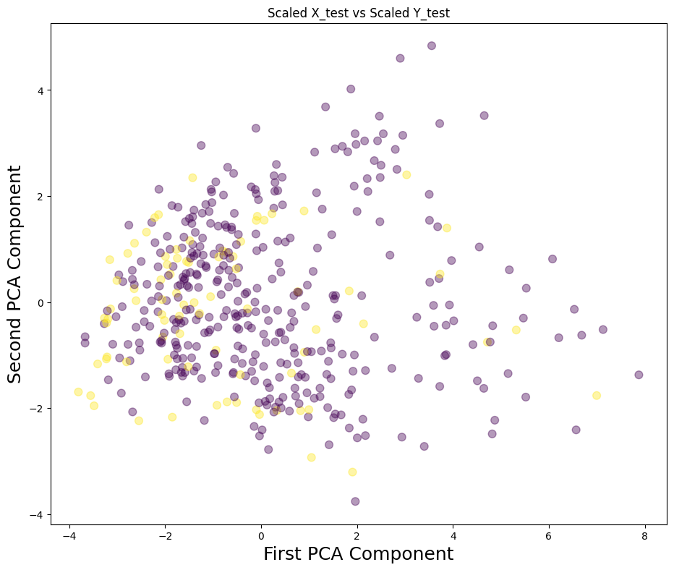
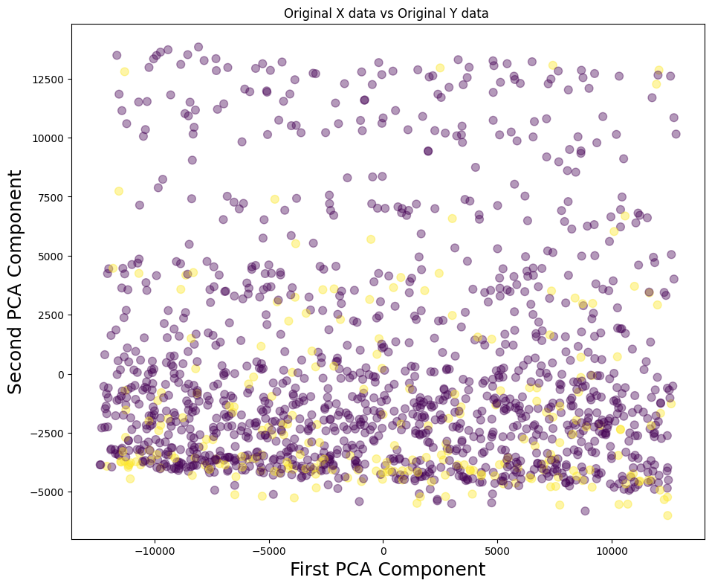
EDA - Principal Component Analysis
We researched and applied principal component analysis (PCA) as part of our exploratory data analysis.

Slide 8
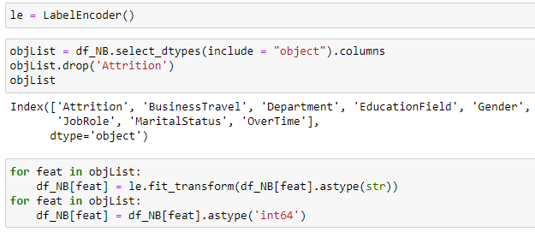
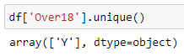
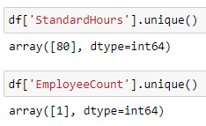
Data Cleaning
Removed columns which added no value and encoded categorical values where appropriate.

Slide 9
Classification Algorithms
KNN
Naïve Bayes
SGD
Adaboost
Logistic Regression
Random Forest
Decision Tree (5.0 & Cart)
Artificial Neural Net

Slide 10
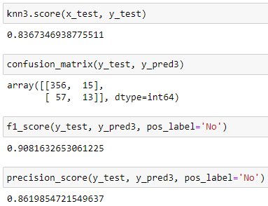
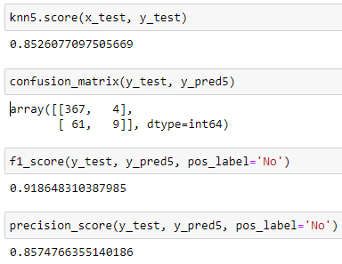
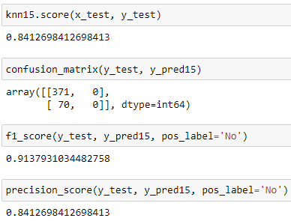
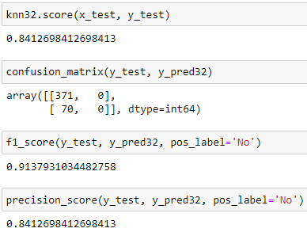
KNN
KNN performed well with various K values. The best results were with a K of 5 – 15. Higher K values resulted in diminishing returns.

Slide 11
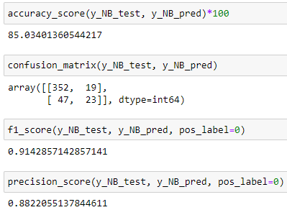
Naïve Bayes
Naïve bayes did not perform as well as knn but still did good.

Slide 12
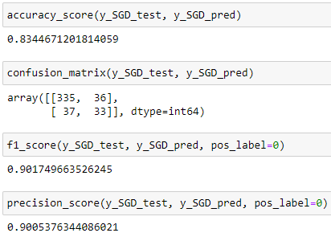
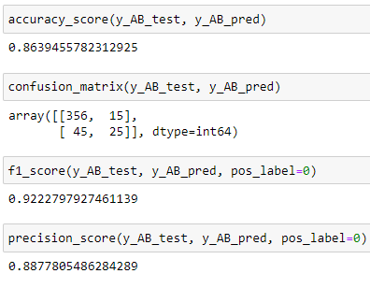
Stochastic Gradient Descent & Ababoost
We researched and applied SGD and Ababoost classifiers. Both performed very well.

Slide 13
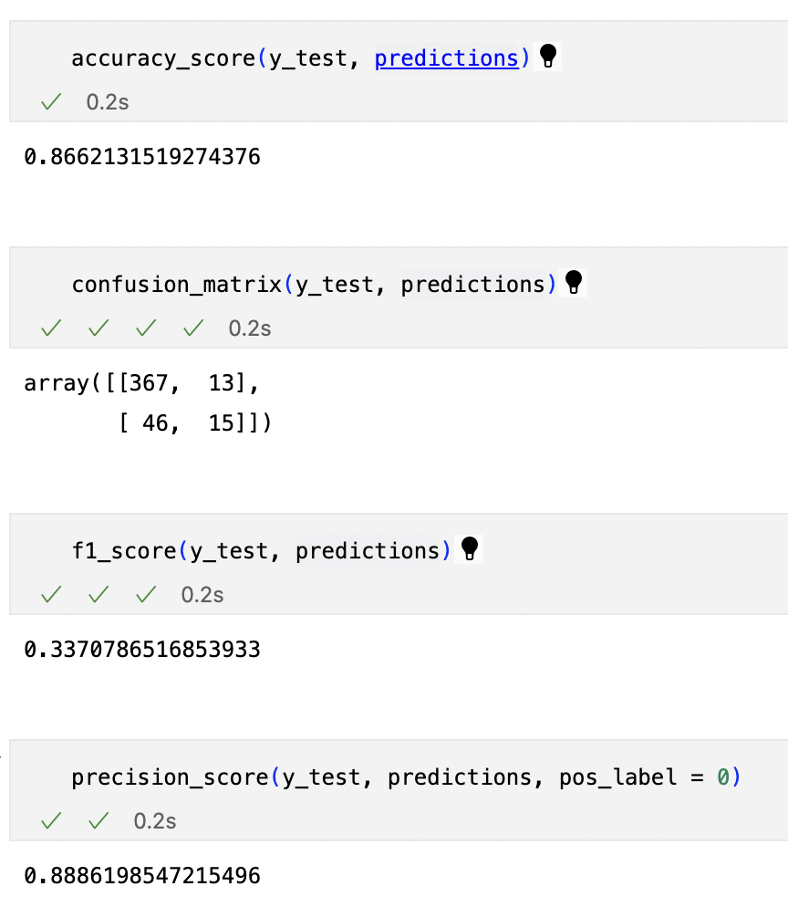
Logistic Regression
We also researched and applied logistic regression, a regression algorithm for classification.

Slide 14
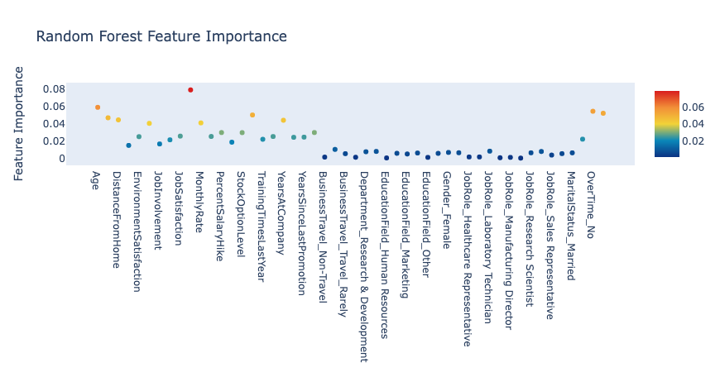
Random Forest – Feature Importance

Slide 15
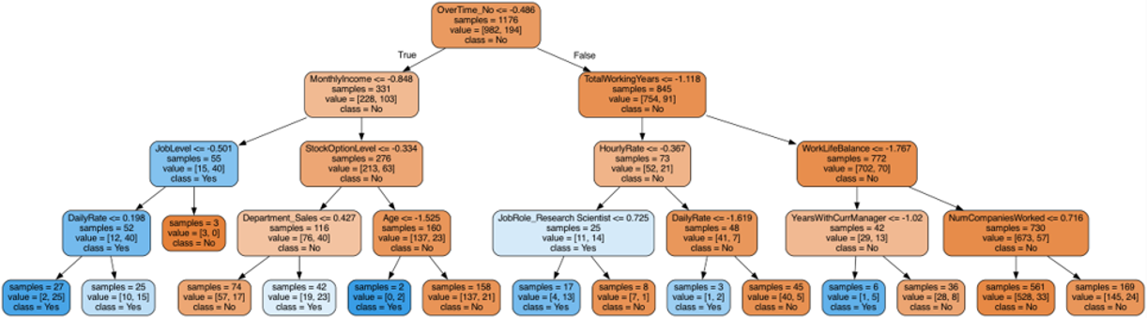
Random Forest – Tree Diagram

Slide 16
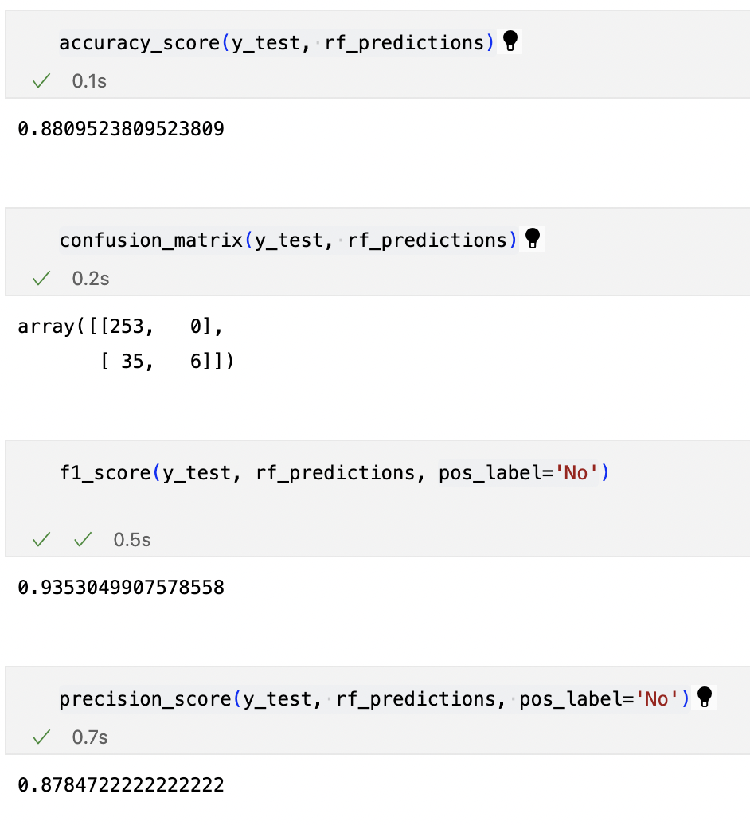
Random Forest
Random forest algorithm performed well with both high accuracy and f1 scores.

Slide 17
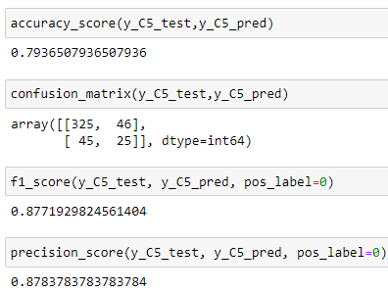
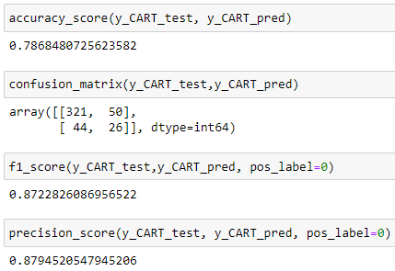
Decision Tree
5.0
CART
Decision Tree algorithm using C5.0 and CART both had comparatively low accuracy scores and low f1 scores

Slide 18
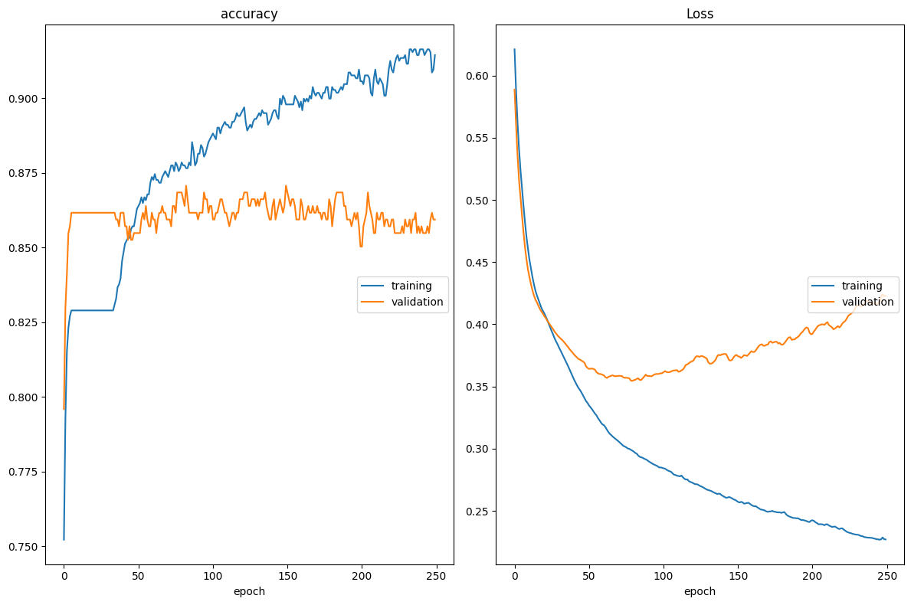
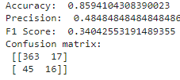
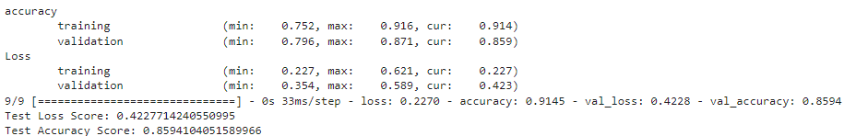
Artificial Neural Net (using TensorFlow) Model 1

Slide 19
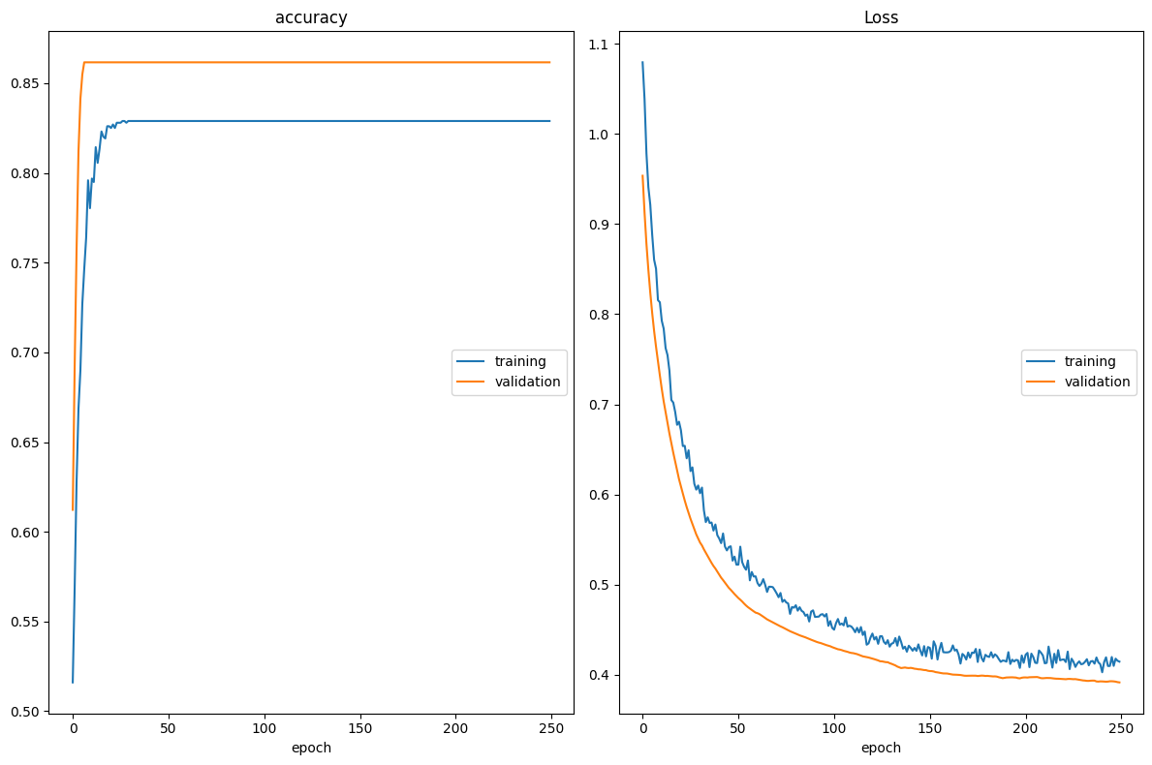
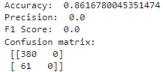
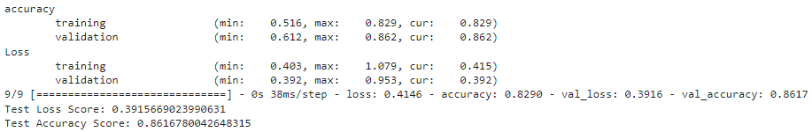
Artificial Neural Net (using TensorFlow) Model 2

Slide 20
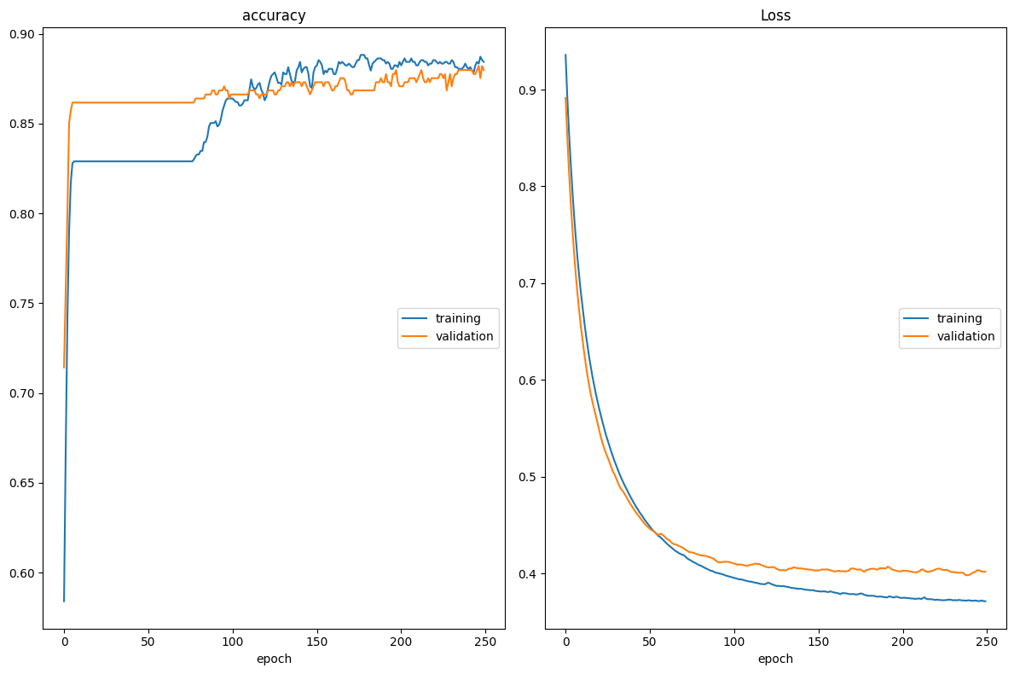
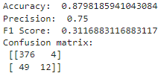
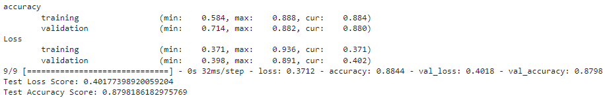
Artificial Neural Net (using TensorFlow) Model 3

Slide 21
Conclusion
The following algorithms were effective at solving the problem
KNN with K=5
Naïve bayes
Adaboost
Logistic
Random forest
Random forest was the best performing algorithm.

Slide 22
Thank you for your attention. Questions?

Slide 23
Find the project here on GitHub
https://github.com/BenWSingleton/CS513FinalProject

